Slide 1
RPicSim
David Grayson
Las Vegas Ruby Meetup
2014-02-12
https://github.com/pololu/rpicsim

Slide 2
The RPicSim gem provides an interface to the MPLAB X PIC simulator that allows you to write simulator-based automated tests of PIC firmware using Ruby and RSpec.

Slide 3
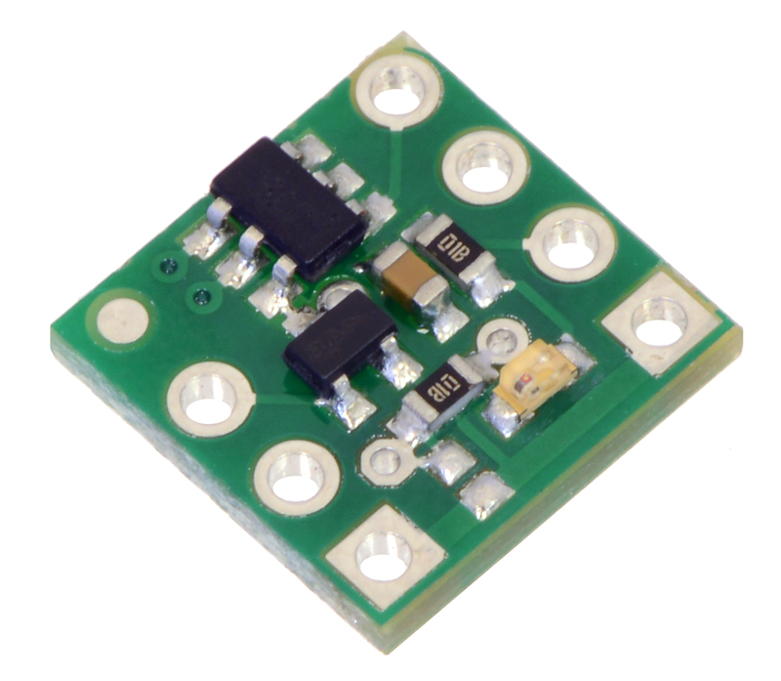
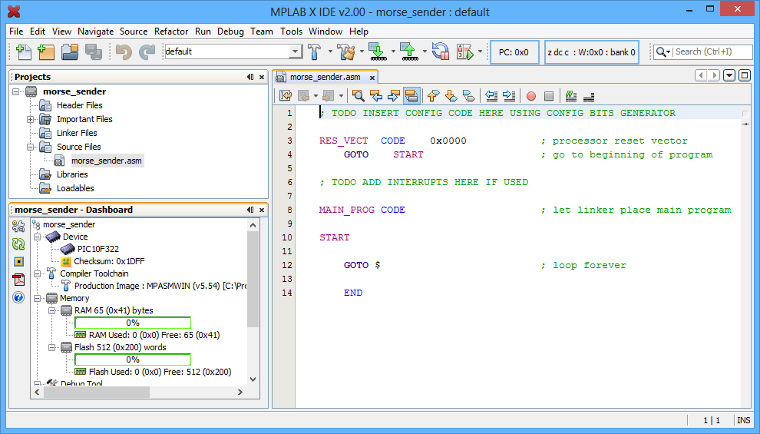

PIC microcontrollers
PIC development tools
RPicSim

Slide 4
PIC microcontrollers
PIC10F322
8-bit architecture
35 instructions
Flash: 512 words
RAM: 64 bytes
http://www.pololu.com/product/2801

Slide 5
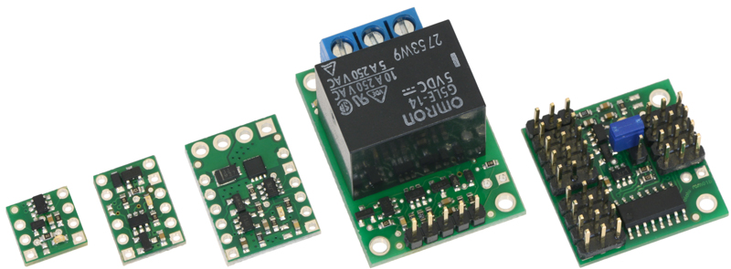

Slide 6
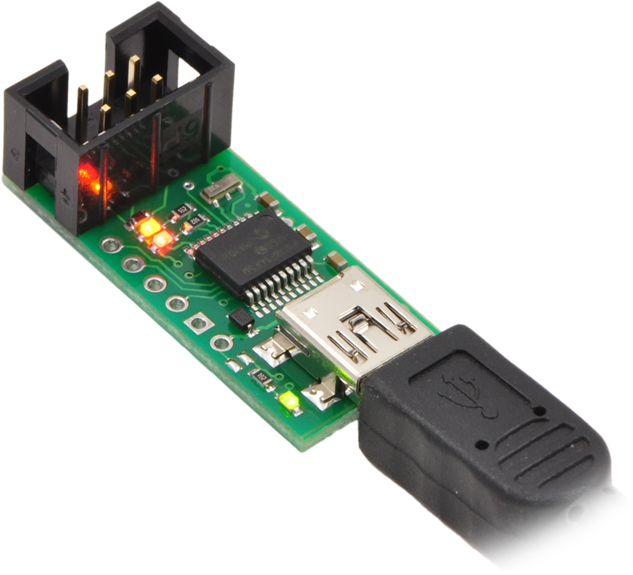

Slide 7
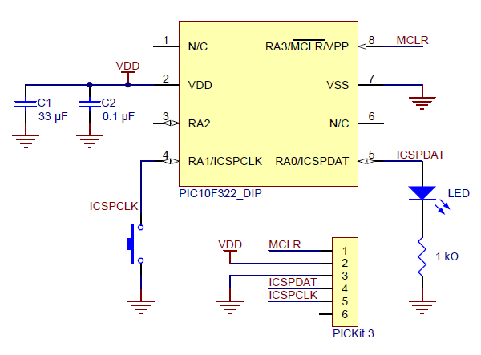

Slide 8
PIC development tools

Slide 9
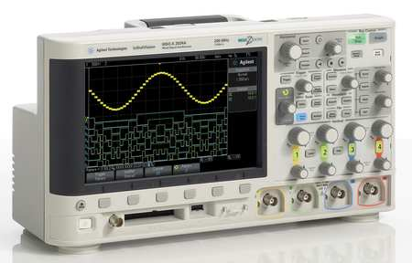
Debugging firmware
Oscilloscope
Dummy code to toggle I/O lines
http://www.zorotools.com/g/00073078/k-G3702447

Slide 10
MPLAB X Simulator

Slide 11
RPicSim

Slide 12
The RPicSim gem provides an interface to the MPLAB X PIC simulator that allows you to write simulator-based automated tests of PIC firmware using Ruby and RSpec.

Slide 13

MPLAB X IDE
MPLAB X Simulator
(jar files)
Notes:
The MPLAB X SDK helped my understand how to do this.

Slide 14
Simulating I/O
it "continuously mirrors" do
main_input.set false
run_cycles 10
expect(main_output).to be_driving_low
main_input.set true
run_cycles 10
expect(main_output).to be_driving_high
end

Slide 15
Persistent expectations
expect(main_output).to be_driving_low
expecting main_output => be_driving_low

Slide 16
Unit test
it 'adds 70 to 22' do
addend1.value = 70
addend2.value = 22
run_subroutine :addition, cycle_limit: 100
expect(sum.value).to eq 92
end

Slide 17
Unit test with RAM watcher
it 'adds 70 to 22' do
addend1.value = 70
addend2.value = 22
step; ram_watcher.clear
run_subroutine :addition, cycle_limit: 100
expect(sim.ram_watcher.writes).to eq({sum: 92})
end

Slide 18
Setup
require 'rpicsim/rspec'
class MySim < RPicSim::Sim
device_is 'PIC10F322'
filename_is File.dirname(__FILE__) + '../src/dist/firmware.cof'
# pin aliases
# variable definitions
# helper methods
end
describe 'some part of the firmware' do
before do
start_sim MySim
end
# examples
end

Slide 19
Stubs
@foo_calls = []
every_step do
if pc.value == label(:foo).address
@foo_calls << { a: foo_param_a.value,
b: foo_param_b.value }
sim.return
end
end

Slide 20
Useful error messages
................................................F.....
Failures:
1) FooWidget when exposed to 1.5 ms pulses behaves correctly
Failure/Error: run_microseconds 1500
expected INTCON to satisfy block
# ./lib/rpicsim/rspec/persistent_expectations.rb:29:in `check_expectations'
# ./lib/rpicsim/rspec/persistent_expectations.rb:27:in `check_expectations'
# ./lib/rpicsim/rspec/helpers.rb:25:in `start_sim'
# ./lib/rpicsim/sim.rb:574:in `step'
# ./lib/rpicsim/sim.rb:716:in `run_to_cycle_count'
# ./lib/rpicsim/sim.rb:708:in `run_cycles'
# ./spec/foo_widget_spec.rb:10:in `(root)'
Simulation cycle count: 78963
Simulation stack trace:
0x01A0 = startMotor
0x0044 = motorService+0x14
0x0B12 = mainLoop+0x2
0x008C = start2
Finished in 4.55 seconds
44 examples, 1 failure
Failed examples:
rspec ./spec/example/nice_error_spec.rb:8 # FooWidget when exposed to 1.5ms pulses behaves correctly

Slide 21
PIC microcontrollers
PIC development tools
RPicSim
Notes:
Say what your hopes are for the project.

Slide 22
For more info:
https://github.com/pololu/rpicsim

Slide 24
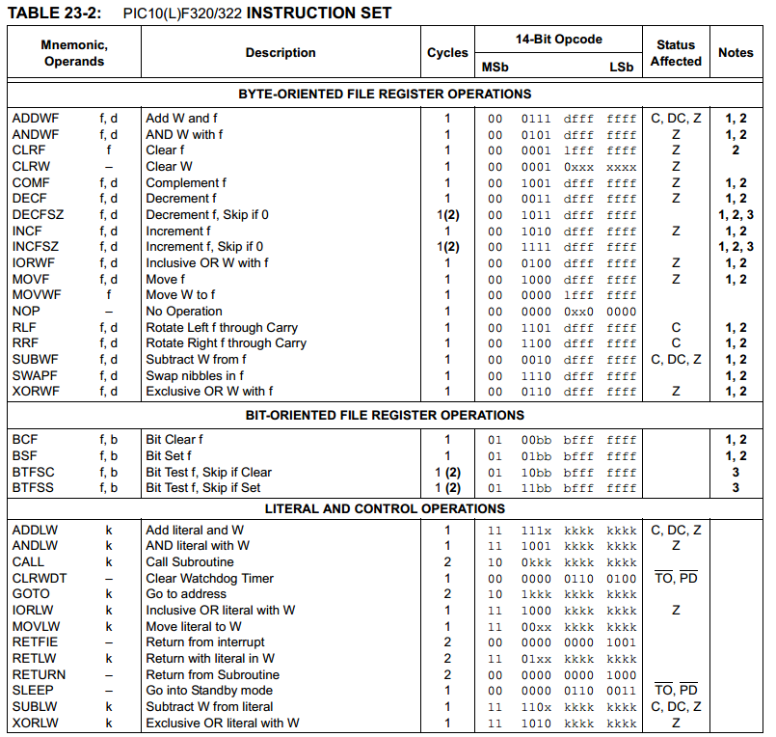
Notes:
PIC10F322 Instruction Set
Look how easy it is to write bugs: MOVF, MOVWF
BTFSC, BTFSS.

Slide 25
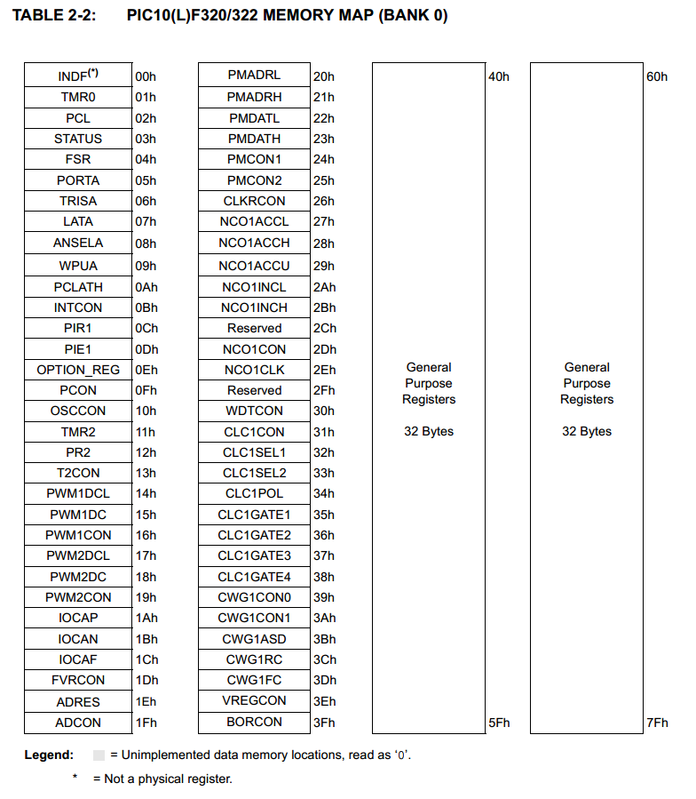
Notes:
These are like global variables in Ruby: $SAFE, $VERBOSE, $?, $1, ARGV.
However, these are the only way to interact with the outside world.

Slide 26
Simplified PIC development steps
Assembler
and/or compiler
Assembly or
C source files
HEX file
Programmer
PIC microcontroller

